Slide 1
Edge2Guard : Botnet Attacks Detecting Offline Models for Resources-Constrained IoT Devices Author: B.Sudarshan et.al Year 2021 , Published on – IEEE
Presented by-
Shalini
MTIS2021-12

Slide 2
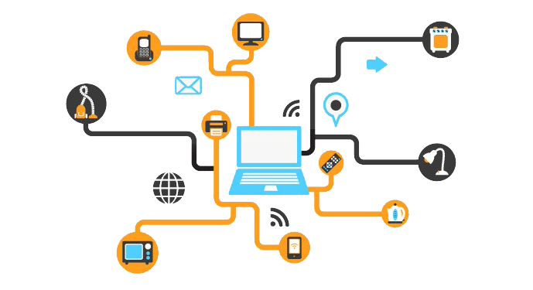

Content
Abstract
Introduction
Background
Related Work
Proposed Methodology
Results
Comparing E2G Results with other models
Conclusion and Future work

Slide 3
Abstract
Dozens of MCU based connected device types exist such as HVAC controllers, smart meters, smoke detectors, etc.
When such device issues and vulnerabilities are exploited, they can be converted into bots whereby severe DDoS attacks can be launched by a botmaster.
Such tiny devices are safe only when connected to networks with defense mechanisms installed in their networking devices like routers and switches, which might not be present everywhere, e.g. on public/free Wi- Fi networks.
Contd..

Slide 4
To safeguard tiny IoT devices from cyberattacks, resource-friendly standalone attack detection models termed Edge2Guard (E2G) enable MCU-based IoT devices to instantly detect IoT attacks without depending on networks or any external protection mechanisms.
During evaluation, top-performing E2G models detected and classified ten types of Mirai and Bashlite malware with close to 100% detection rates.

Slide 5
Introduction
Methods from recent research enable users to fit, deploy and execute advanced ML models on quite basic chipsets that are highly resource-constrained.
On the other hand, algorithms are emerging to enable resource-constrained IoT devices to self-learn from evolving real-world data
Such algorithms are not of much use when an IoT application powered by them gets easily compromised during cyberattacks like DDoS (Distributed Denial of Service) attacks.

Slide 6
Despite the existence of such high threats, the security conditions of widely deployed essential IoT devices remain unsatisfactory.
Since such tiny chipset devices are highly resource-constrained with only a few MB of memory and have limited computational power, it is highly challenging to implement practical attack protection mechanisms.
To safeguard tiny IOT devices , we cannot expect network based attack detection mechanism on all external networks . For example: Smartwatch connected to dubious network

Slide 7
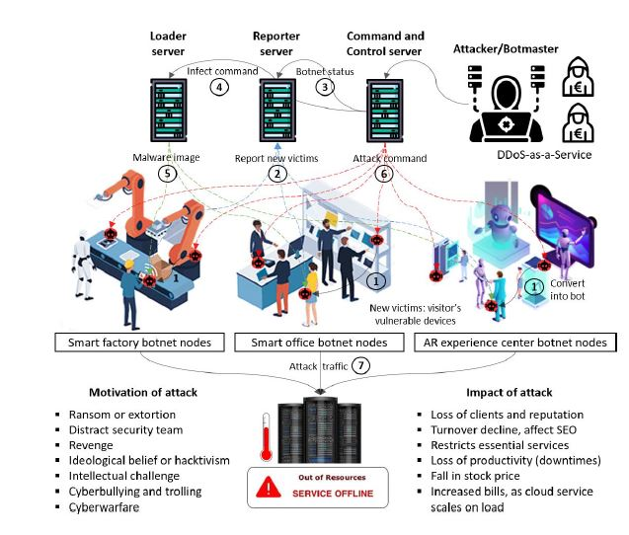
Background :

Slide 8
Related Work
OCSVM detection mechanism for application-layer DDoS attacks.
Honeypots detect botnet DDoS attacks by capturing device malware installation attempts using unsupervised methods.
ANN-based method accurately discovered several application-layer DDoS attacks.
N-BaIoT , an autoencoder, was proposed to detect anomalous network traffic from compromised IoT devices bots.
CNN-based DDoS attack detection and warning system.
Many on-device methods were left uncited, and offline (network independent) methods for resource-constrained IoT devices were not mentioned at all.

Slide 9
Proposed Methodology
Dataset and IOT Devices
2 type of Malware - Mirai , Bashlite
5 Categories and 9 IoT Devices - Baby monitor, Webcam, Security Camera, Doorbell, Thermostat
For each data packet, the 115 features provided in the dataset that we use for training
Set of 23 features with 100ms, 500ms, 1.5sec, 10sec, 1 min time interval.
for each device, under each attack class, 5 subclasses represent the type and class of traffic. Hence, it contains 80 files with attack traffic data, 9 files (one for each device) with benign (regular) traffic data, and the overall dataset contains around 7 million instances.

Slide 10
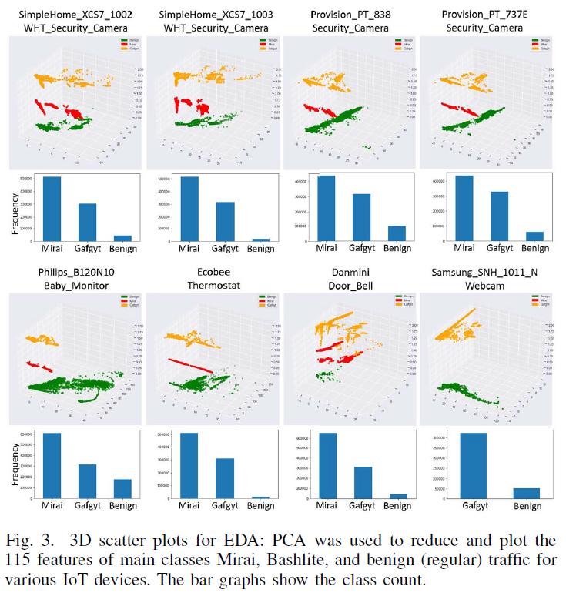
B. Exploratory Data Analysis
Used a PCA dimensionality reduction method to mathematically reduce the 115 features into two features.
Which they plotted and visualized in Fig-3 in order to explore the patterns and find out trends between the malicious and benign traffic data.

Slide 11
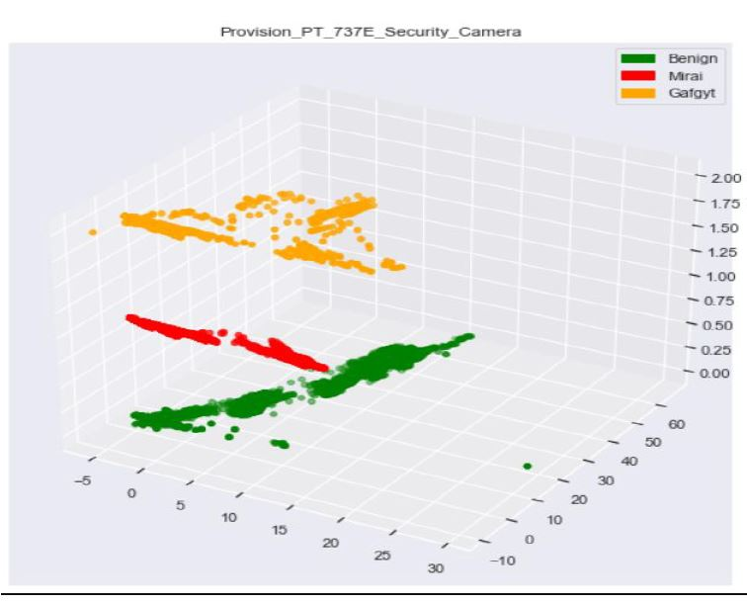
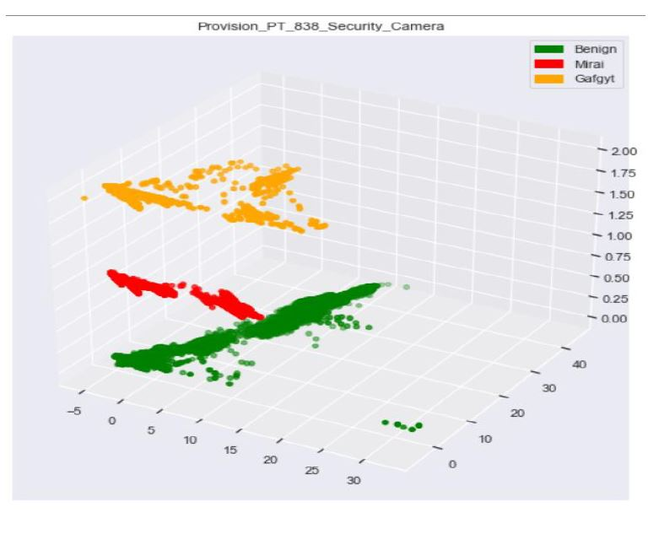

Slide 12
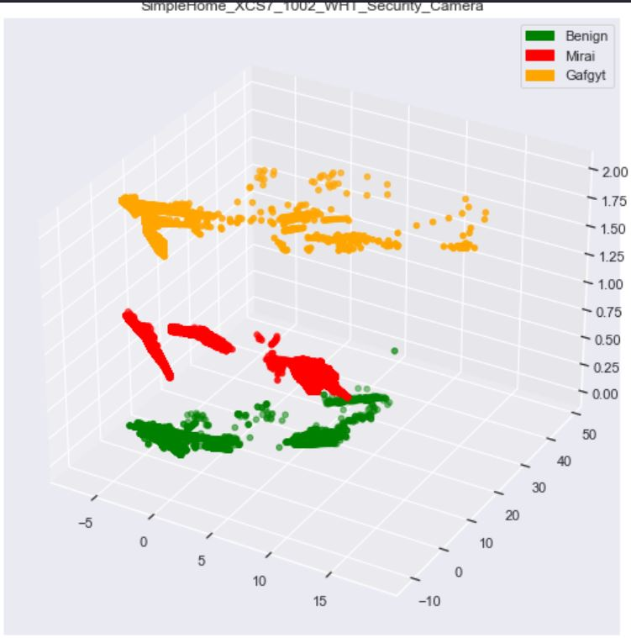
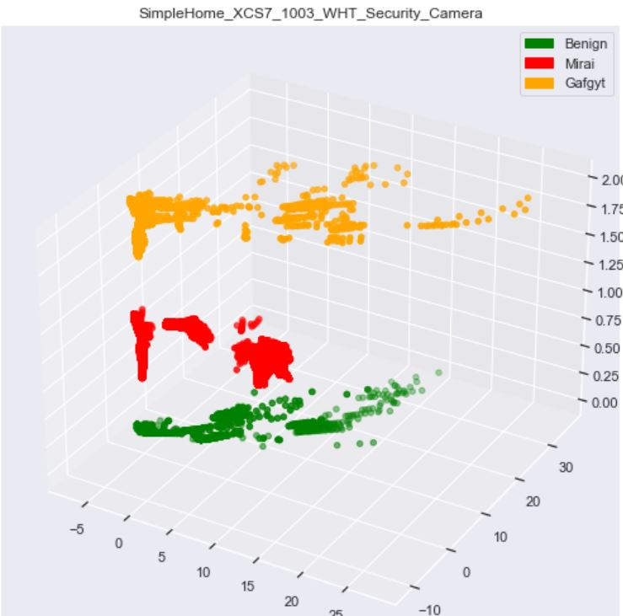
Mirai and Bashlite malware behave same away for devices from the same brand.

Slide 13
C. Data Pre-processing
Data is highly imbalanced (unequal distribution of classes).Hence we need to pre-process the dataset before training in order to obtain unbiased E2G model
Data is pre-processed into four categories :
All Data with 3 Classes: Classify the main class names i.e., wether the input data in Mirai or Bashlite or benign
All Data with 11 classes :Classify exactly which subclass the input data belongs to in Mirai, bashlite and benign ie., :benign ,gafgyt_combo ,gafgyt_junk ,gafgyt_scan,gafgyt_syn,gafgyt_udp ,mirai_ack ,mirai_scan ,mirai_syn ,mirai_udp ,mirai_udpplain
All Data with 3 classes Under Sampled .
All Data with 11 Classes Under sampled .
Followed 70-30 Training and test split.

Slide 14
D. E2G Model Design and Evaluation
The processed data can be used to build E2G models in three different approaches.
In the first approach, training a generic E2G model using the entire dataset that can detect attacks on any IoT device.
Second, we can build one model for each category of device, i.e. one E2G model for cameras and another for doorbells.
Third, we build separate models for each IoT device using the processed benign and attack traffic data of the corresponding devices

Slide 15
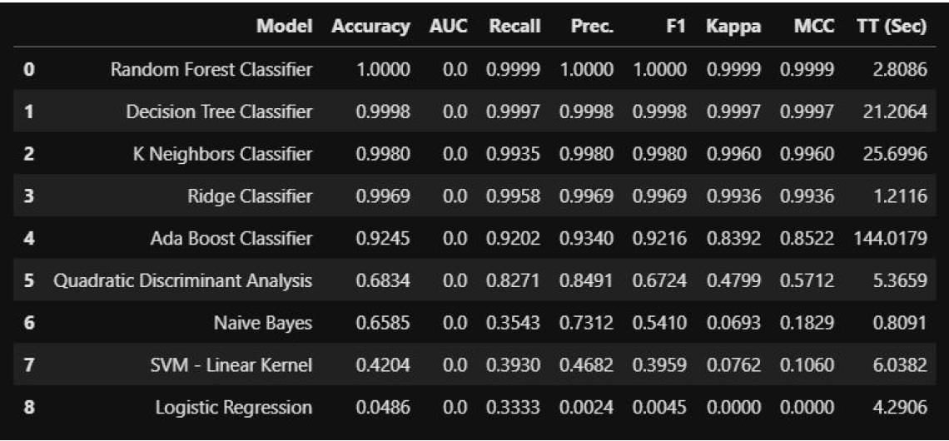
E2G Supervised Learning Models :
Used danmini doorbell data with the Pycaret python module to test it’s baseline accuracy and F1 Score.

Slide 16
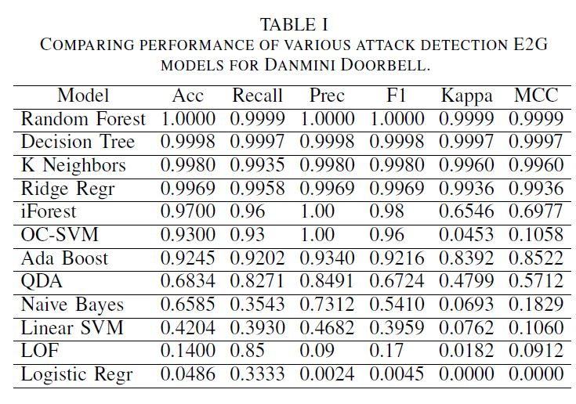
E2G One class Classification Models:
There is a high chance of updates being released after the device has been compromised.
In the OCC approach, we train models just using the device-specific benign data and consider other hundreds of types of malware attack data like Mirai, Bashlite, etc. as outliers.
We apply One-Class Support Vector Machines (OC-SVM), Isolation Forest (iForest), and a Local Outlier Factor (LOF) on the 115 features

Slide 17
Top-performing E2G Models for IoT Devices
The iForest and OC-SVM OCC models perform reasonably well and also are more feasible to design ,smaller in size, and easy to maintain.
However, we choose RF and DT because, in attack detection use cases,even if a single instance of attack traffic is misclassified as benign, the device will get compromised.
Here, as planned, for each IoT device, we train individual RF and DT E2G models for attack detection.
All the individual models are evaluated and shown on next slide

Slide 18
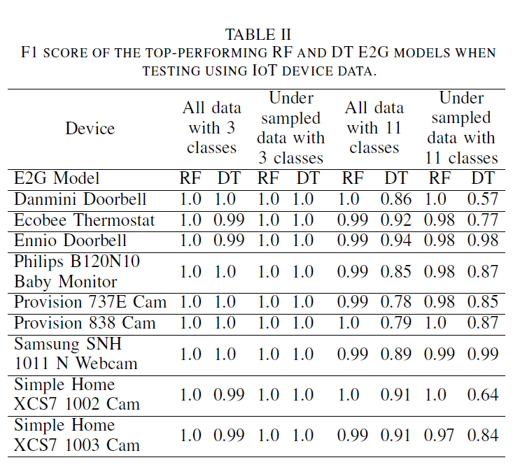
Results

Slide 19
Comparing E2G Results with Other Methods
When comparing the performance of our E2G with papers that cite and use the N-BaIoT dataset, our RF and DT E2G models outperformed the other models by showing close to 100% detection rates.
Next, when compared with the standard host-based and network deployed approaches ,users can benefit more when they use E2G models because of their standalone, offline attack detection capabilities that protect devices even when connected to dubious networks by mistake.

Slide 20
Conclusion & Future Work
They have presented E2G models that can be comfortably executed within the limited resource of tiny IoT devices and can classify malware attack traffic in real time.
In future work, we can aim to deploy this models on devices and test them using real-world data.
We can also implement and add a resource-friendly authentication , prevention and alert mechanism that enables E2G models to perform post-attack detection actions.

Slide 21
THANK YOU

